Slide 1

DIVERSITY OF THE MICROBIAL WORLD

Slide 2
Microbial World
A major biologic division separates the eukaryotes and prokaryotes
Cells from animals, plants, and fungi are eukaryotes (Greek for "true nucleus"), whereas bacteria and blue-green algae belong to the prokaryotes (Greek for "primitive nucleus").
www.themegallery.com
Company Logo

Slide 3
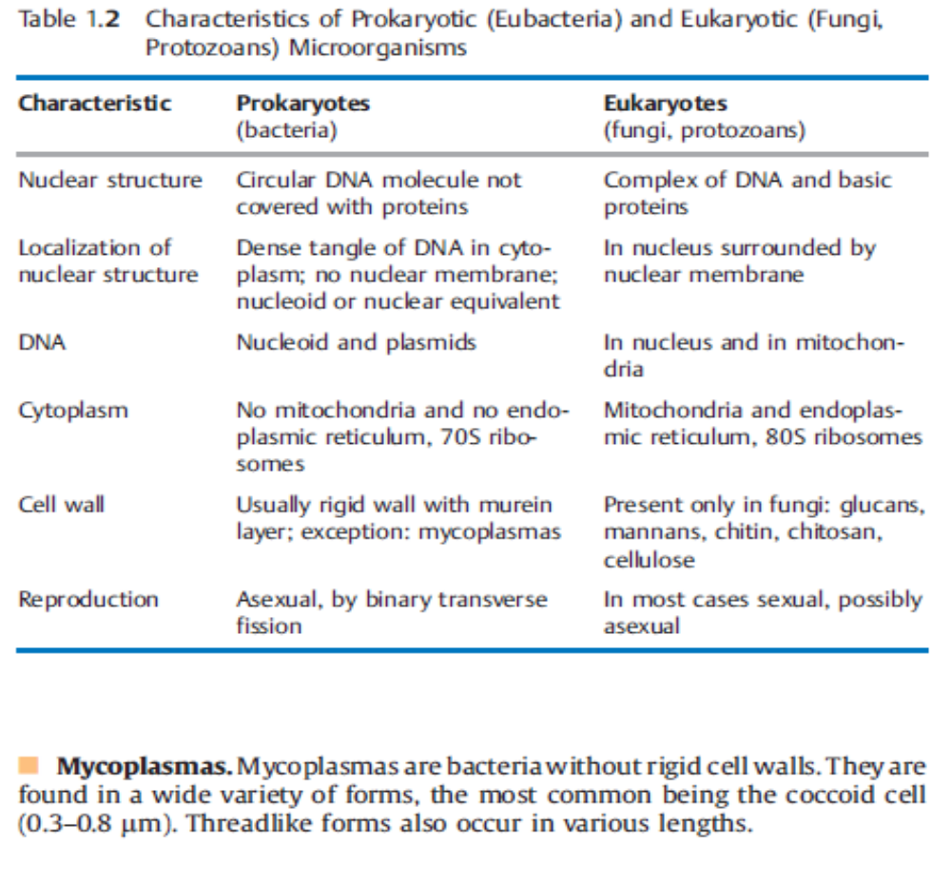
Prokaryotes - Eukaryotes
www.themegallery.com
Company Logo

Slide 4
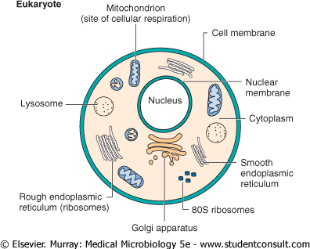
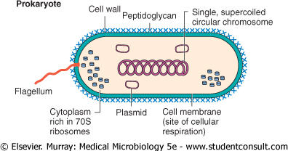
Prokaryotes - Eukaryotes
www.themegallery.com
Company Logo

Slide 5
Taxonomy and Classification
Classification, nomenclature, and identification are the three separate but interrelated areas of taxonomy
Classification can be defined as the arrangement of organisms into taxonomic groups (taxa) on the basis of similarities or relationships
Nomenclature is naming an organism by international rules according to its characteristics
www.themegallery.com
Company Logo

Slide 6
Taxonomy and Classification
Identification refers to the practical use of a classification scheme:
  (1) to isolate and distinguish desirable organisms from undesirable ones;
  (2) to verify the authenticity or special properties of a culture; or, in a clinical setting,
  (3) to isolate and identify the causative agent of a disease.
refers to the classification and grouping of organisms
based on genotypic (genetic) and phenotypic (observable) similarities and differences
www.themegallery.com
Company Logo

Slide 7
Taxonomy and Classification
Phenotypic Classification of Bacteria:
  Microscopic morphology
  Macroscopic morphology
  Biotyping
  Serotyping
  Antibiogram patterns
  Phage typing
Genotypic Classification of Bacteria:
  Guanine plus cytosine ratio
  DNA hybridization
  Nucleic acid sequence analysis
  Plasmid analysis
  Ribotyping
  Chromosomal DNA fragment analysis
www.themegallery.com
Company Logo

Slide 8
Numerical Taxonomy
Also called computer taxonomy, phenetics, or taxometrics
Numerical classification schemes use a large number (frequently 100 or more) of unweighted taxonomically useful characteristics
The computer clusters different strains at selected levels of overall similarity (usually > 80% at the species level) on the basis of the frequency with which they share traits.
www.themegallery.com
Company Logo

Slide 9
Taxonomy
According to a proposal by Woese, the world of living things is classified in the three domains bacteria, archaea, and eucarya. In this system, each domain is subdivided into kingdoms.
Bacteria:
  heterotrophic eubacteria → all human pathogen bacteria
  photosynthetic cyanobacteria → not pathogenic
www.themegallery.com
Company Logo

Slide 10
Taxonomy
Bacteria:
  Classic bacteria → reproduce asexually by binary transverse fission
  Chlamydiae → obligate intracellular parasites
  Rickettsiae → obligate intracellular parasites, rod shaped to coccoid, that reproduce by binary transverse fission
  Mycoplasmas → bacteria without rigid cell walls
www.themegallery.com
Company Logo

Slide 11
The rank of taxonomy can be seen in this table:
Grading | Example
Kingdom | Prokaryote
Division | Gracilicutes
Class | Scotobacteria
Order | Eubacteriales
Family | Enterobacteriaceae
Genus | Escherichia
Species | coli
www.themegallery.com
Company Logo

Slide 12
Nomenclature
provides naming assignments for each organism
family name is capitalized and has an-aceae ending (e.g., Micrococcaceae)
genus name is capitalized and followed by the species name, begins with a lowercase letter; should be italicized in print but underlined in the script (e.g., Staphylococcus aureus or Staphylococcus aureus)
www.themegallery.com
Company Logo

Slide 13
Nomenclature
using the first letter of the genus followed by a period and the species epithet (name) (e.g., S. aureus)
Species abbreviated sp. (singular) or spp. (plural) is used when the species is not specified
When referred to as a group, their names are neither capitalized nor underlined (e.g., staphylococci)
The plural of genus is genera (e.g., Enterobacteriaceae family)
www.themegallery.com
Company Logo

Slide 14
Morphology and Structure
Although bacteria are difficult to differentiate by size, they do have different shapes
Bacteria vary in size from 0.4 to 2 μm occur in three basic shapes:
  Cocci (spherical)
  Bacilli (rod-shaped)
  Spirochetes (helical)
Cocci: singly, pairs (diplococci), chains (streptococci), clusters (staphylococci)
www.themegallery.com
Company Logo

Slide 15
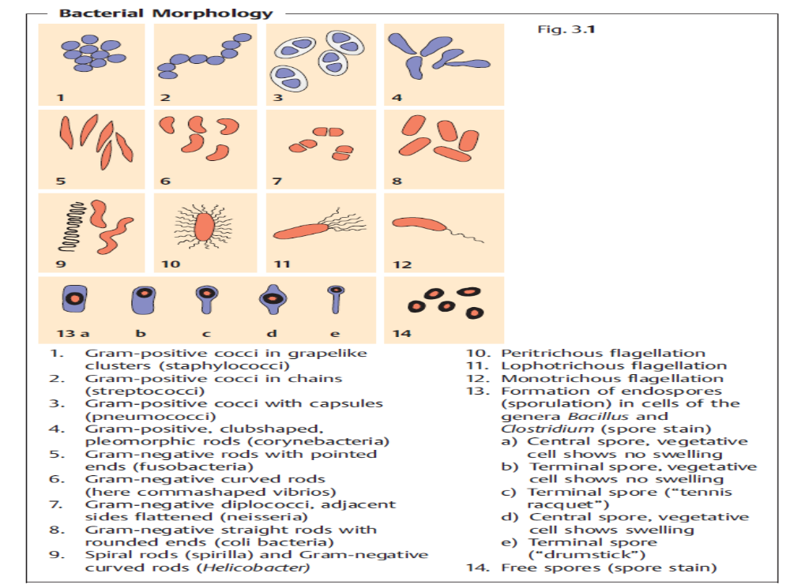
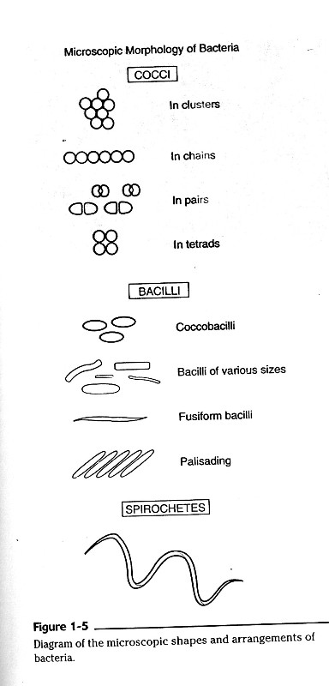
Morphology and Structure
www.themegallery.com
Company Logo

Slide 16
Morphology and Structure
Bacilli: very short coccobacilli → long filamentous rods, ends may be square or rounded
Bacilli with tapered, pointed ends →fusiform
a species varies in size and shape within a pure culture → pleomorphic
Bacilli may occur as single rods or in chains or may align themselves side by side (palisading)
www.themegallery.com
Company Logo

Slide 17
Major Characteristics of Eukaryotes and Prokaryotes
Characteristic | Eukaryote | Prokaryote
Major groups | Algae, fungi, protozoa, plants, animals | Bacteria
Size (approximate) | >5 μm | 0.5-3.0 μm
Nuclear Structures
Nucleus | Classic membrane | No nuclear membrane
Chromosomes | Strands of DNA Diploid genome | Single, circular DNA Haploid genome
Cytoplasmic Structures
Mitochondria | Present | Absent
Golgi bodies | Present | Absent
Endoplasmic reticulum | Present | Absent
Ribosomes (sedimentation coefficient) | 80S (60S +40S) | 70S (50S +30S)
www.themegallery.com
Company Logo

Slide 18
Major Characteristics of Eukaryotes and Prokaryotes
Characteristic | Eukaryote | Prokaryote
Cytoplasmic membrane | Contains sterols | Does not contain sterols
Cell wall | Present for fungi; otherwise absent | Is a complex structure containing protein, lipids, and peptidoglycans
Reproduction | Sexual and asexual | Asexual (binary fission)
Movement | Complex flagellum, if present | Simple flagellum, if present
Respiration | Via mitochondria | Via cytoplasmic membrane
www.themegallery.com
Company Logo

Slide 19
Eukaryotic Cell Structure
The nucleus contains the cell's genome
The inner membrane is usually a simple sac, but the outermost membrane is continuous with the endoplasmic reticulum
The chromosomes of eukaryotic cells contain linear DNA macromolecules arranged as a double helix.
A structure often visible within the nucleus is the nucleolus, an area rich in RNA that is the site of ribosomal RNA synthesis.
www.themegallery.com
Company Logo

Slide 20
Cytoplasmic Structures
The cytoplasm of eukaryotic cells is characterized by the presence of an endoplasmic reticulum, vacuoles, self-reproducing plastids, and an elaborate cytoskeleton composed of microtubules, microfilaments, and intermediate filaments.
A variety of anaerobic or aerotolerant eukaryotic microorganisms (eg, Trichomonas vaginalis) lack mitochondria and contain instead a membrane-enclosed respiratory organelle called the hydrogenosome.
www.themegallery.com
Company Logo

Slide 21
Cytoplasmic Structures
The cytoplasm is enclosed within a plasma membrane composed of protein and phospholipid, similar to the prokaryotic cell membrane
Many eukaryotic microorganisms have organelles called flagella or cilia that move with a wave-like motion to propel the cell through water
Eukaryotic flagella emanate from the polar region of the cell, whereas cilia, which are shorter than flagella, surround the cell
www.themegallery.com
Company Logo

Slide 22
Flagella
Flagella is accessory structure of bacteria, seen filamentous, is built from protein, only found at bacillus shape bacteria. Flagella is used in bacterial movement.
Depends on amount and catching to bacteria it is classified in :
Atricous : unflagella
Monotricous : single flagella on one of pole
Lophotricous : more than 2 flagella on one of pole
Amphitricous : more than 2 flagella on either poles
Peritricous : many flagella surrounding cell body of bacteria
www.themegallery.com
Company Logo

Slide 23
Prokaryotic Cell Structure
The nucleoid of bacterial cells has long been considered to consist of a single continuous circular molecule with a molecular weight of approximately 3 x 10⁹. It may thus be considered to be a single, haploid chromosome, approximately 1 mm long in the unfolded state
www.themegallery.com
Company Logo

Slide 24
Cytoplasmic Structures
Prokaryotic cells lack autonomous plastids, such as mitochondria and chloroplasts; the electron transport enzymes are localized instead in the cytoplasmic membrane
Microtubular structures, which are characteristics of eukaryotic cells, are generally absent in prokaryotes
www.themegallery.com
Company Logo

Slide 25
The Cell Envelope
Bacteria are classified as gram-positive or gram-negative according to their response to the Gram staining procedure → named for the histologist Hans Christian Gram: who developed this differential staining procedure in an attempt to stain bacteria in infected tissues.
The cells are first stained with crystal violet and iodine and then washed with acetone or alcohol. The latter step decolorizes gram-negative bacteria but not gram-positive bacteria.
www.themegallery.com
Company Logo

Slide 26
The Cell Envelope
The difference between gram-positive and gram-negative bacteria has been shown to reside in the cell wall: Gram-positive cells can be decolorized with acetone or alcohol if the cell wall is removed after the staining step but before the washing step. Although the chemical composition of gram-positive and gram-negative walls is now fairly well known (see below), the reason gram-positive walls block the dye-extraction step is still unclear.
www.themegallery.com
Company Logo

Slide 27
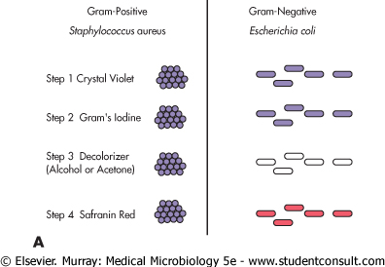
Gram Staining
www.themegallery.com
Company Logo

Slide 28
Bacterial Membrane Structures
Structure | Chemical Constituents
Plasma membrane | Phospholipids, proteins, and enzymes involved in generation of energy, membrane potential, and transport
Cell Wall
Gram-positive bacteria
Peptidoglycan | Glycan chains of GlcNAc and MurNAc cross-linked by peptide bridge
Teichoic acid | Polyribitol phosphate or glycerol phosphate cross-linked to peptidoglycan
Lipoteichoic acid | Lipid-linked teichoic acid
Gram-negative bacteria
Peptidoglycan | Thinner version of that found in gram-positive bacteria
Periplasmic space | Enzymes involved in transport, degradation, and synthesis
Outer membrane | Phospholipids with saturated fatty acids
www.themegallery.com
Company Logo

Slide 29
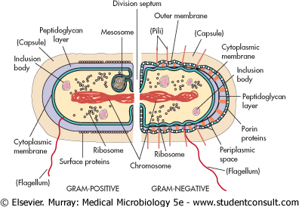
Bacterial Membrane Structures
Structure | Chemical Constituents
Proteins | Porins, lipoprotein, transport proteins
LPS | Lipid A, core polysaccharide, O antigen
Other structures
Capsule | Polysaccharides (disaccharides and trisaccharides) and polypeptides
Pili | Pilin, adhesins
Flagellum | Motor proteins, flagellin
Proteins | M protein of streptococci (as an example)
www.themegallery.com
Company Logo

Slide 30
Pathogenesis of the Bacterial Infections
The terms pathogenicity and virulence are not clearly defined in their relevance to microorganisms. They are sometimes even used synonymously.
It has been proposed that pathogenicity be used to characterize a particular species and that virulence be used to describe the sum of the disease-causing properties of a population (strain) of a pathogenic species
www.themegallery.com
Company Logo

Slide 31
Pathogenesis
Relatively little is known about the factors determining the pathogenicity and virulence of microorganisms, and most of what we do know concerns the disease-causing mechanisms of bacteria.
Pathogenicity → Capacity of a pathogen species to cause disease
Virulence Sum of the disease-causing properties of a strain of a pathogenic species
www.themegallery.com
Company Logo

Slide 32
Incubation & Colonization
Incubation period Time between infection and manifestation of disease symptoms; this specific disease characteristic can be measured in hours, days, weeks, or even years
Colonization Presence of microorganisms on skin or mucosa; no penetration into tissues; typical of normal flora; pathogenic microorganisms occasionally also show colonization behavior
www.themegallery.com
Company Logo

Slide 33
Infection
Infection → Invasion of a host organism by microorganisms, proliferation of the invading organisms, and host reaction
Inapparent (or subclinical) infection → Infection without outbreak of clinical symptoms
Infectious disease (or clinical infection) → Infection with outbreak of clinical symptoms
www.themegallery.com
Company Logo

Slide 34
Infection
Probability of manifestation → Frequency of clinical manifestation of an infection in disposed individuals (%)
Endogenous infection Infection arising from the colonizing flora
Exogenous infection Infection arising from invasion of host by microorganisms from sources external to it
Nosocomial infection Infection acquired during hospitalization (urinary tract infections, infections of the respiratory organs, wound infection, sepsis)
www.themegallery.com
Company Logo

Slide 35
Infection
Local infection Infection that remains restricted to the portal of entry and surrounding area
Generalized infection Lymphogenous and/or hematogenous spread of invading pathogen starting from the portal of entry; infection of organs to which pathogen shows a specific affinity (organotropism); three stages: incubation, generalization, organ manifestation
www.themegallery.com
Company Logo

Slide 36
Infection
Transitory bacteremia/viremia/parasitemia → Brief presence of microorganisms in the bloodstream
Superinfection: Occurrence of a second infection in the course of a first infection
Relapses: Series of infections by the same pathogen
Reinfection: Series of infections by different pathogens
www.themegallery.com
Company Logo

Slide 37
Pathogenesis of infectious disease
There are five groups of potential bacterial contributors to the pathogenesis of infectious diseases:
  Adhesins. They facilitate adhesion to specific target cells.
  Invasins. They are responsible for active invasion of the cells of the macroorganism.
  Impedins. These components disable host immune defenses in some cases.
  Aggressins. These substances include toxins and tissue-damaging enzymes.
  Modulins. Substances that induce excess cytokine production (i.e., lipopolysaccharides of Gram-negative bacteria, superantigens, murein fragments).
www.themegallery.com
Company Logo

Slide 38
Invasion and Spread
Invasion. Bacteria may invade a host passively through microtraumata or macrotraumata in the skin or mucosa. On the other hand, bacteria that invade through intact mucosa first adhere to this anatomical barrier, then actively breach it.
Spread. Local tissue spread beginning at the portal of entry, helped along by tissue-damaging exoenzymes (hyaluronidase, collagenase, elastase, and other proteases).
www.themegallery.com
Company Logo

Slide 39
Spread
Cell-to-cell spread. Bacteria translocated into the intracellular space by endocytosis cause actin to condense into filaments, which then array at one end of the bacterium and push up against the inner side of the cell membrane. This is followed by fusion with the membrane of the neighboring tissue cell, whereupon the bacterium enters the new cell (typical of Listeria and Shigella).
www.themegallery.com
Company Logo

Slide 40
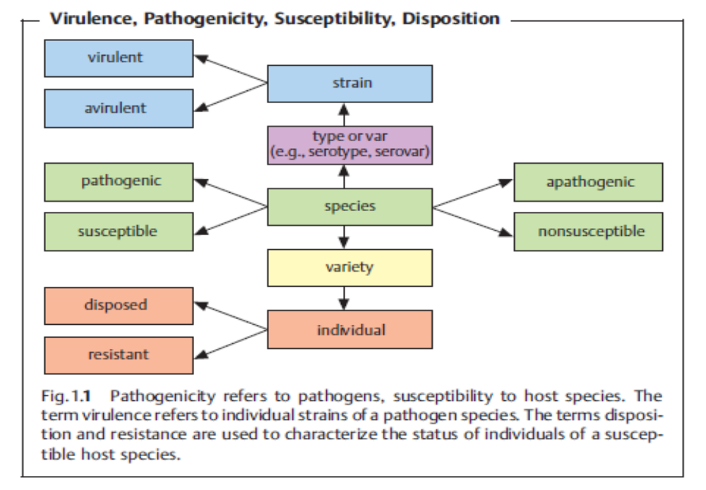
Virulence, Pathogenicity, Susceptibility, Disposition
www.themegallery.com
Company Logo

Slide 41
Thank You !
Alhamdulillah

